Slide 1
Python Unit Testing

Slide 2
Why Software testing is important?
To point out the defects during the development phases.
To Ensure that the application works as expected.

Slide 3
Test Driven Development.
The process of implementing code by writing your tests first, seeing them fail, then writing the code to make the tests pass.
Write Tests
Make Them fail
Write code.
Make them pass
Repeat

Slide 4
Python Unit test
Some Important Points
Every test class must be sub class of unittest.TestCase
Every test function should start with test name.
to check for an expected result use assert functions.
The setUp() method define instructions that will be executed before test case.
The tearDown() method define instructions that will be executed after test
case.

Slide 5
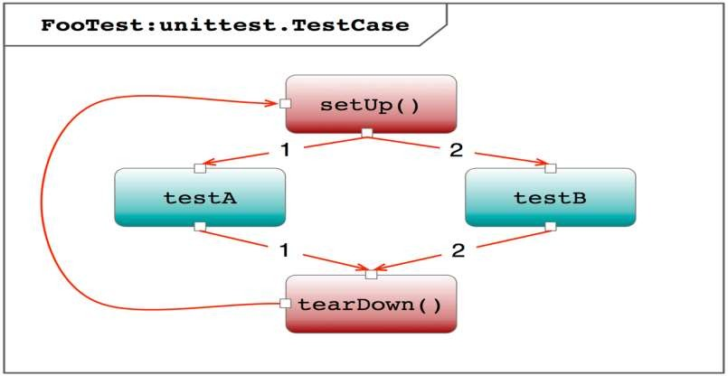

Slide 6
Let’s start
# tests/mul.py
def multiply(a, b):
return a*b
def add(a, b): return a+b

Slide 7
Test case
import unittest
from mul import multiply
class MultiplyTestCase(unittest.TestCase):
def test_multiplication_with_correct_values(self): self.assertEqual(multiply(5, 5), 25)
if name == ' main ':
unittest.main()

Slide 8
SetUp() and TearDown()
class MulTestCase(unittest.TestCase):
def setUp(self):
self.a = 10
self.b = 20
# Runs before every test method
def test_mult_with_correct_values(self):
self.assertEqual(multiply(self.a, self.b), 200) def tearDown(self): # runs after every test method
del self.a del self.b
if name == ' main ':
unittest.main()

Slide 9
Assert functions
assertEqual(a, b)
assertNotEqual(a, b)
assertTrue(x)
assertFalse(x)
assertIs(a, b)
https://docs.python.org/2/library/unittest.html#test-cases

Slide 10
Nose:
$ pip install nose
# Running tests
$ nosetests

Slide 11
Doc Tests:
# tests/mul_dc.py
def multiply(a, b): """
>>> multiply(4, 3)
12 """
return a * b
# running
$ python -m doctest -v file_name

